Slide 1
Introduction to CS 106B
CS 106B
June 20, 2011

Slide 2

Logistics
Course Overview
First Program
Excited?

Slide 3
Logistics
Course Overview
First Program
Excited?

Slide 4
Essential Information
cs106b.stanford.edu

Slide 5

Candy Policy

Slide 6

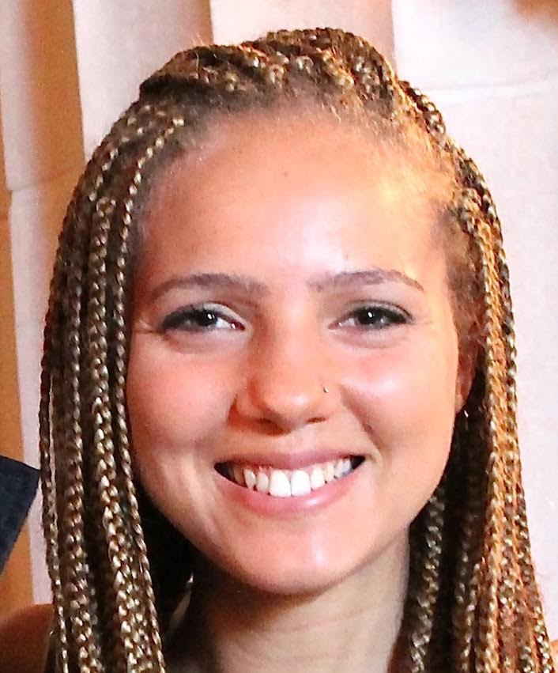
CS 106B Staff
Lecturer: Chris Piech
piech@cs.stanford.edu
Office Gates 193
Office Hours:
Mon 1:30pm -2:30pm
Wed 2:30pm-4:00pm
Head TA: Megan Faulk
mfaulk@stanford.edu
Office Gates B02
Office Hours:
TBA

Slide 7
Is CS106B The Right Class?
CS 106A: Programming Methodology (ENGR 70A)
Introduction to the engineering of computer applications emphasizing modern software engineering principles: object-oriented design, decomposition, encapsulation, abstraction, and testing. Uses the Java programming language. Emphasis is on good programming style and the built-in facilities of the Java language. No prior programming experience required.
Terms: Aut, Win, Spr, Sum | Units: 3-5 | UG Reqs: GER:DBEngrAppSci | Grading: Letter or Credit/No Credit
Instructors: Burr, B. (PI); Cain, G. (PI); Cooper, S. (PI); Jimenez, O. (PI); Sahami, M. (PI)
CS 106X: Programming Abstractions (Accelerated) (ENGR 70X)
Intensive version of 106B for students with a strong programming background interested in a rigorous treatment of the topics at an accelerated pace. Additional advanced material and more challenging projects.
Prerequisite: excellence in 106A or equivalent, or consent of instructor.
Terms: Aut, Win| Units: 3-5 | UG Reqs: GER:DBEngrAppSci | Grading: Letter or Credit/No Credit
Instructors: Cain, G. (PI)

Slide 8
Assignments in CS106B
Due at 5:00P.M.
Three free “late days”
Extensions approved by Megan or Chris.
Graded by your section leader
Interactive, one-on-one grading session.
Graded on Style and Functionality.

Slide 9


The CS106B Grading Scale
Functionality and style grades for the assignments use the following scale:
A submission so good it “makes you weep.”
Exceeds requirements.
Satisfies all requirements of the assignment.
Meets most requirements, but with some problems.
Has more serious problems.
Is even worse than that.
Better than nothing.

Slide 10
Sections
Weekly 50-min section led by awesome section leaders (the backbone of the class!)
Signups begin on Thursday at 5:00pm and close Sunday at 5:00pm

Slide 11
Staff Contact
Post to Piazza
Contact your Section Leader
Go to the LaIR or Office Hours
Email cs106b-win1516-staff@lists.stanford.edu
Call us.

Slide 12
Grade Breakdown

Slide 13

Programming Challenge

Slide 14
Honor Code Rules
Rule 1:
You must indicate on your submission any assistance you received.
Rule 2:
You must not share actual program code with other students.
Rule 3:
You must not look at solutions posted on the web or from other years.
Rule 4:
You must be prepared to explain any program code you submit.

Slide 15
Logistics
Course Overview
First Program
Excited?

Slide 16
Logistics
Course Overview
First Program
Excited?

Slide 17



The C++ Decision

Slide 18
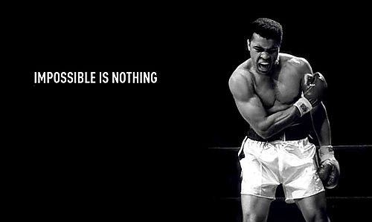
The Big Ideas in CS106B
Recursion.
Data abstraction.
Beautiful algorithms.

Slide 19
Logistics
Course Overview
First Program
Excited?

Slide 20
Logistics
Course Overview
First Program
Excited?

Slide 21

Ready to Dive In?

Slide 22
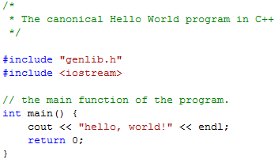
Hello, World!

Slide 23
Hello, World!

Slide 24
Hello, World!

Slide 25
Hello, World!

Slide 26
Hello, World!

Slide 27
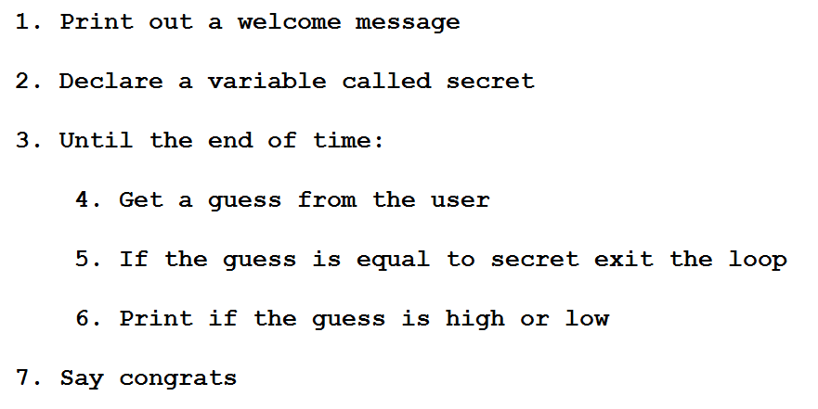
Guessing Game

Slide 28
Logistics
Course Overview
First Program
Excited?

Slide 29
Logistics
Course Overview
First Program
Excited?

Slide 30
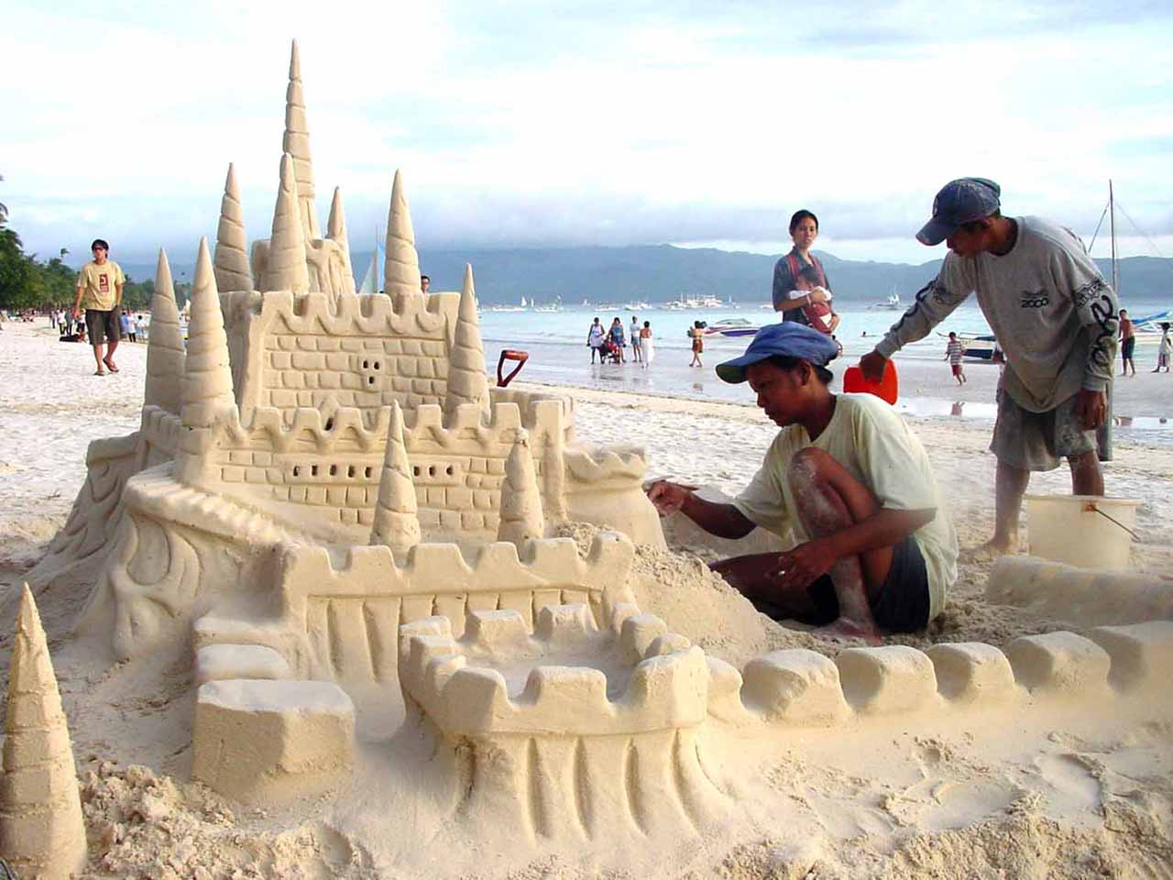

Why CS?

Slide 31

Why CS?

Slide 32


Why CS?

Slide 33

Why CS?

Slide 34
The End.

Slide 35

The End?

